Slide 1

Alpha-SQL: Zero-Shot Text-to-SQL using Monte Carlo Tree Search
Yuyu Luo
The Hong Kong University of Science and Technology (Guangzhou)
https://luoyuyu.vip/
yuyuluo@hkust-gz.edu.cn

Slide 2


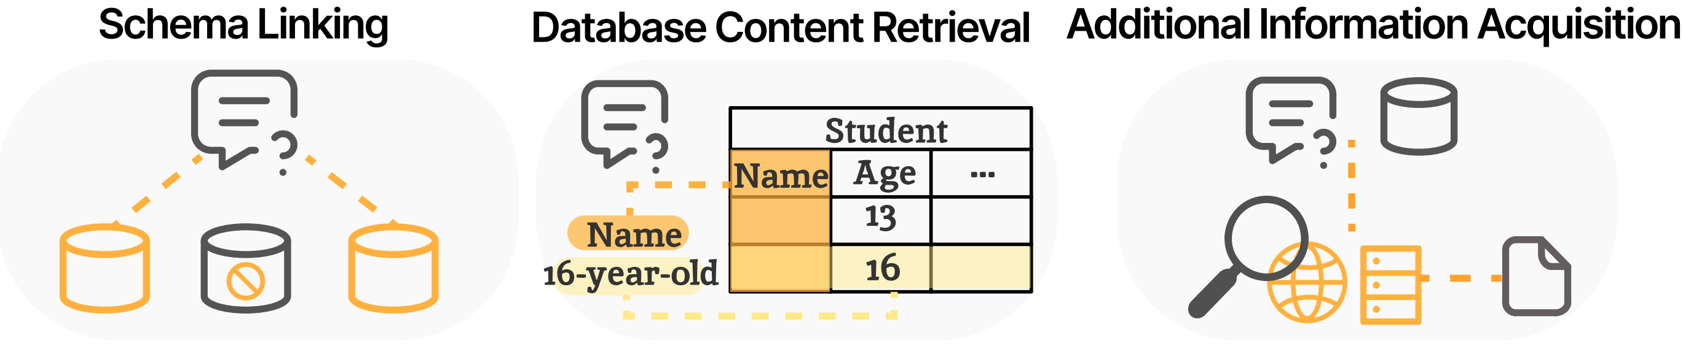

Text-to-SQL: Bridges Humans and Databases
Who are the three youngest winners across all matches? And their ranks?
NL Query
DB Information
Users
Text-to-SQL Model
SQL
SELECT winner_name, winner_rank FROM matches ORDER BY winner_age LIMIT 3

Slide 3
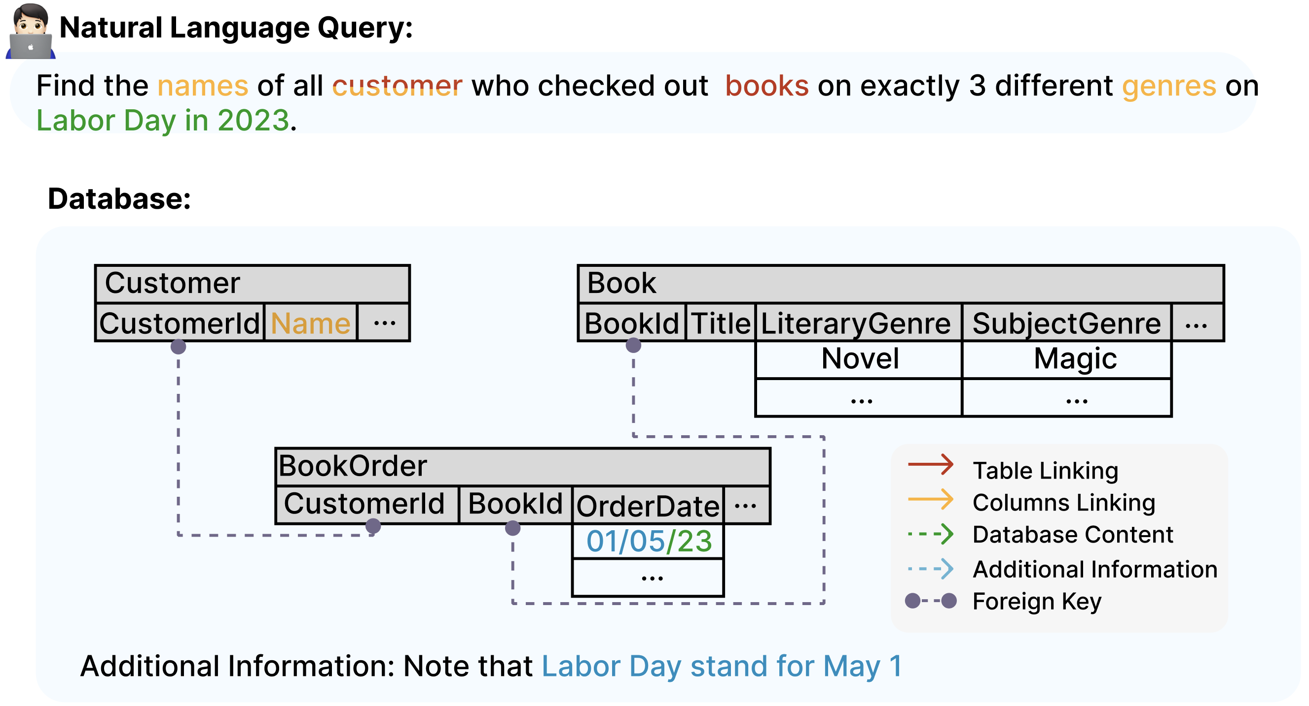
Task Challenges
C1. Ambiguous NL Query
C2. Requiring Domain Knowledge
C3. Complex Database Schema
C1
C3
C2

Slide 4
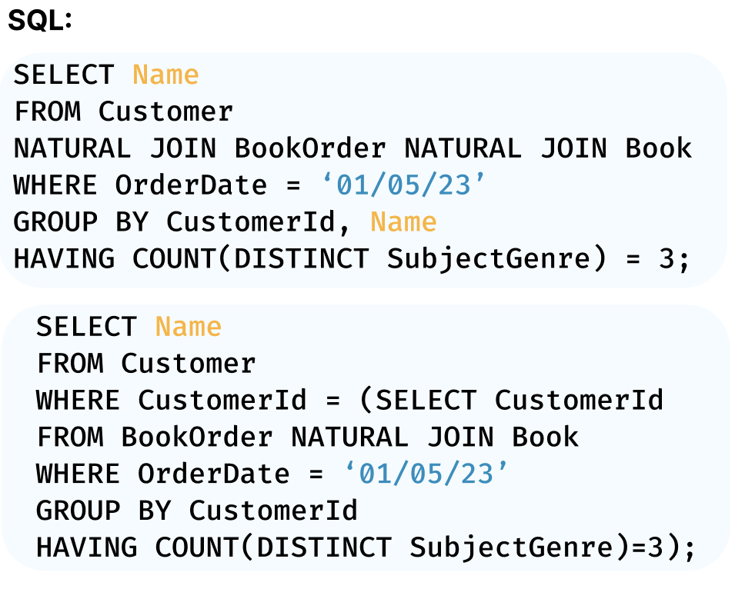
Task Challenges
C1. Ambiguous NL Query
C2. Requiring Domain Knowledge
C3. Complex Database Schema
C4. Multiple Possible SQL Queries
C1
C3
LiteraryGenre
C1
C2
LiteraryGenre
3

Slide 5
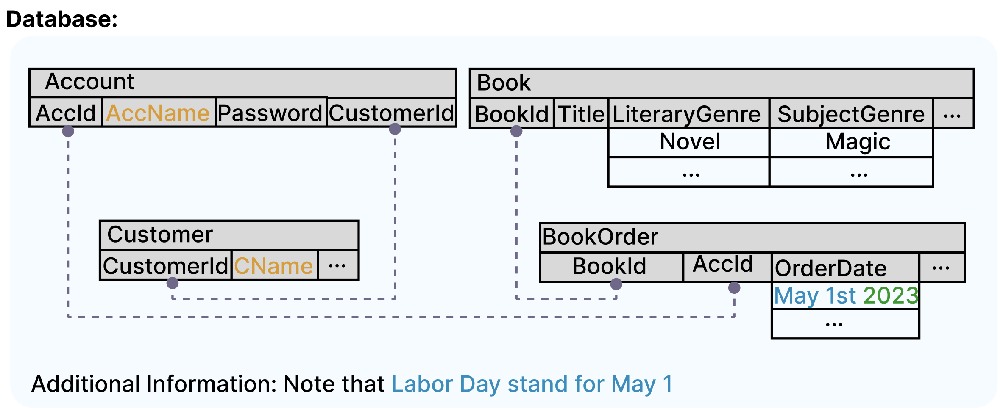
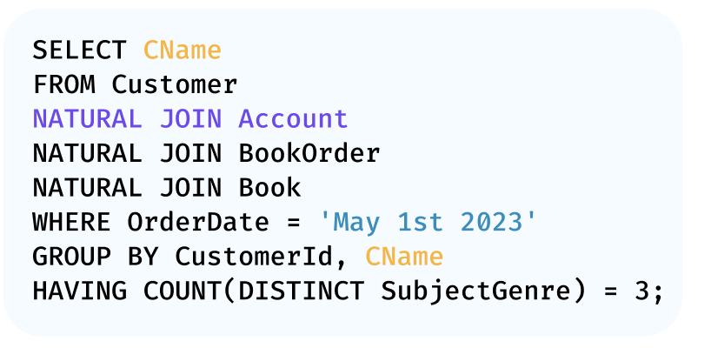
Task Challenges
C1. Ambiguous NL Query
C2. Requiring Domain Knowledge
C3. Complex Database Schema
C4. Multiple Possible SQL Queries
C5. Database Schema Dependency
C6. Database Domain Adaption
4

Slide 6
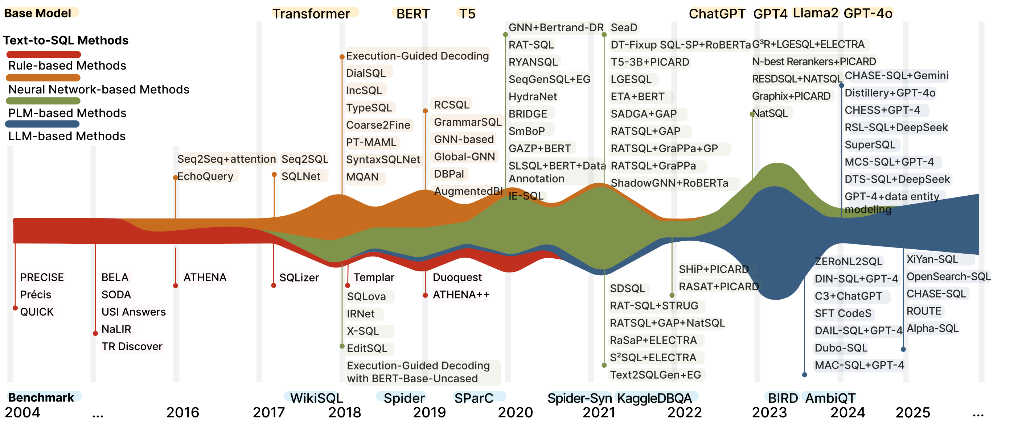
Where Are We?
https://github.com/HKUSTDial/NL2SQL_Handbook

Slide 7
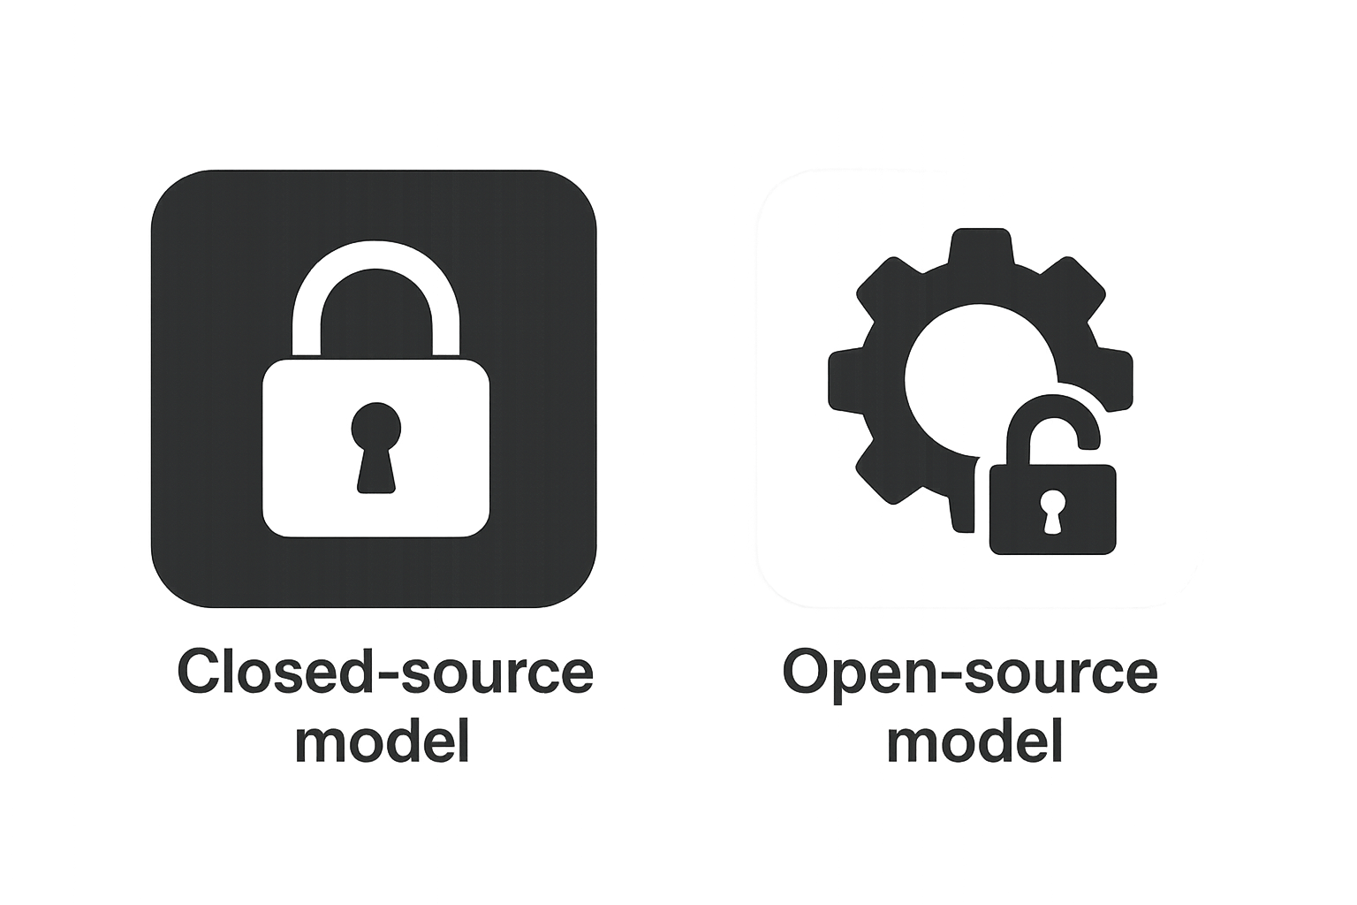
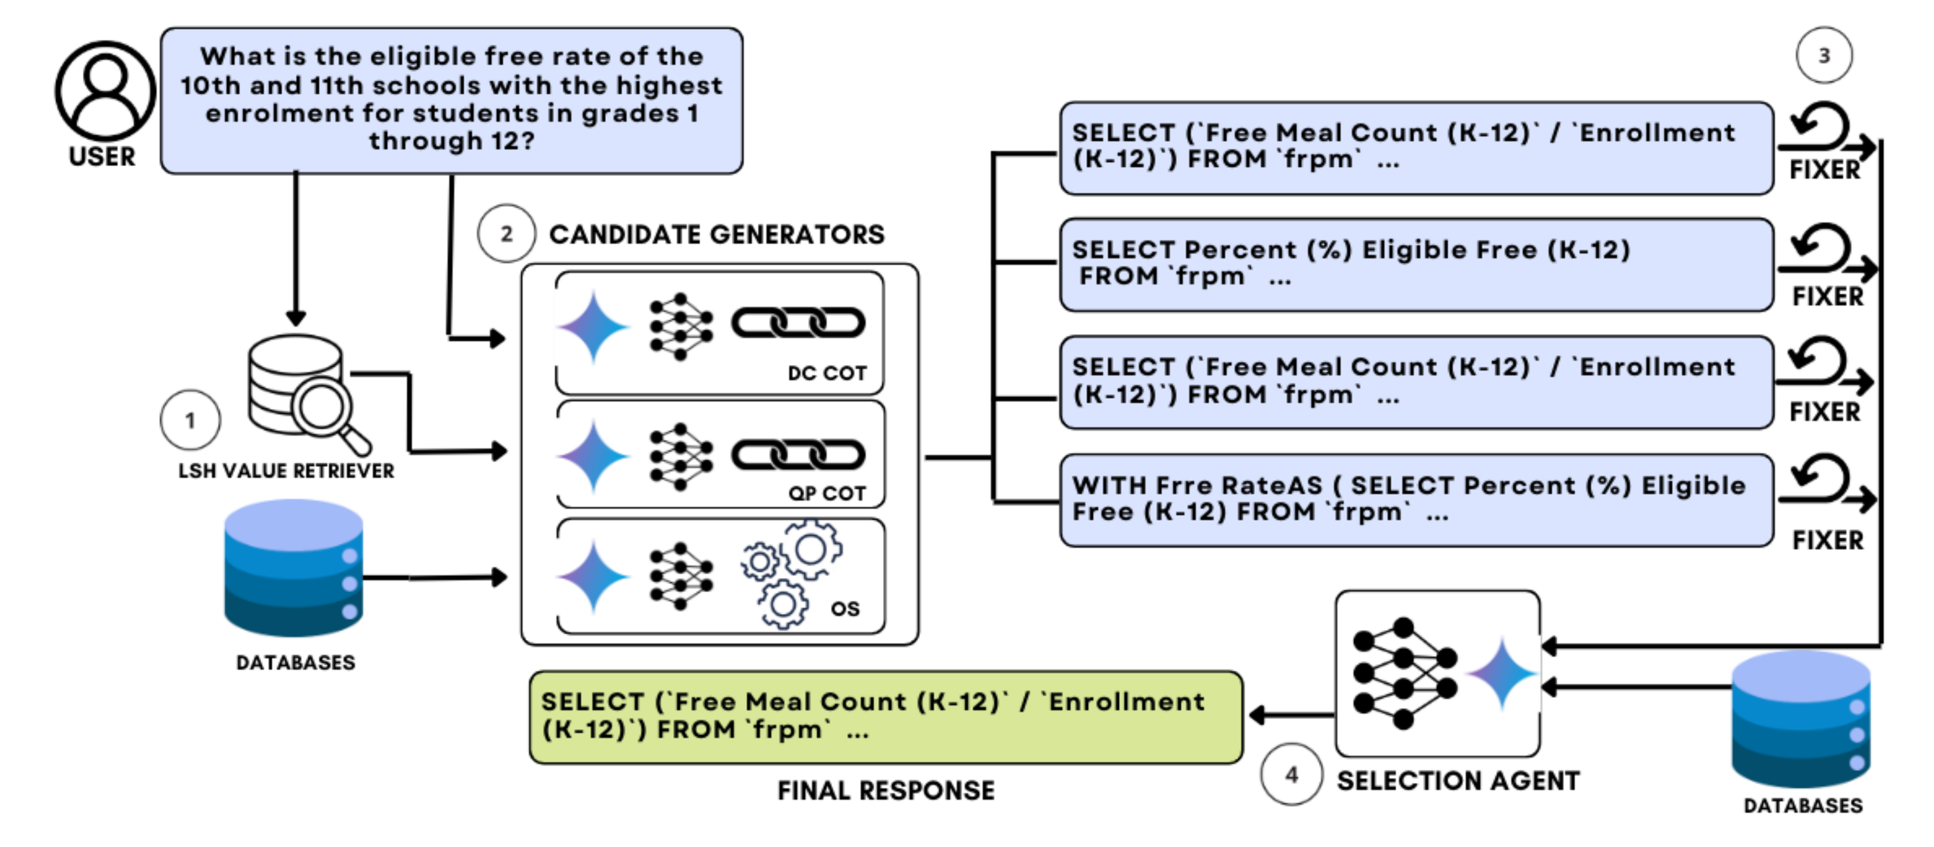
Where Are We?
CHASE-SQL [ICLR 2025], by Google Cloud and Stanford
Utilizes the MinHash LSH to search for values related to the user query
Multiple prompting strategies to generate various candidate SQL queries using LLMs, and corrects SQL queries with execution errors through prompting LLMs.
Employs an SQL selection agent fine-tuned specifically for the database to select the final SQL from multiple candidates.
Closed-source
LLMs

Slide 8
Where Are We?
CHASE-SQL [ICLR 2025], by Google Cloud and Stanford
Closed-source
LLMs
Key Limitations:
Reliance on closed-source large models
High cost (0.6 USD/query), making it difficult to widely deploy in real-world industrial scenarios.
SQL selection agent requires fine-tuning
The Google team fine-tuned the Gemini-1.5-Flash model specifically.
Limited flexibility due to reliance on domain-specific data.
Predefined and Fixed Reasoning Workflows

Slide 9
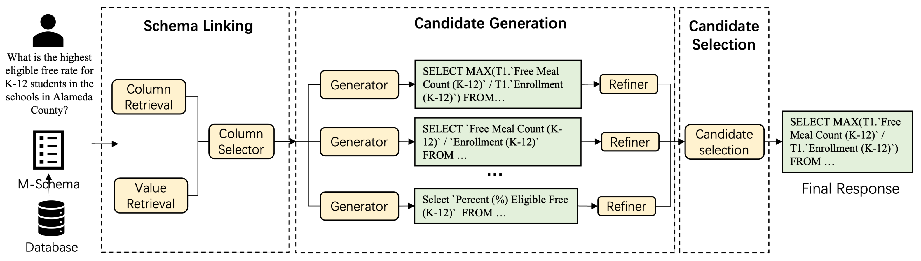
Where Are We?
XiYan-SQL, by Alibaba
M-Schema: Uses column and value retrieval to select relevant schema items from DBs.
Fine-tunes a base LLM on SQL-specific data, then creates multiple specialized SQL-generation models by fine-tuning with diverse Text-to-SQL syntax datasets.
Employs a fine-tuned SQL selection model to choose the best SQL from predictions made by multiple generators.
Open-source LLMs

Slide 10
Where Are We?
XiYan-SQL, by Alibaba
Open-source LLMs
Key Limitations:
High dependency on extensive domain-specific data.
Significant costs associated with fine-tuning multiple models.
Difficulty in rapid adaptation and generalization across varied scenarios.
Predefined and Fixed Reasoning Workflows.

Slide 11
Key Takeaways
Closed-source LLMs for Text-to-SQL:
High inference API cost limits practical deployments.
Potential data privacy concerns for sensitive applications.
Open-source LLMs for Text-to-SQL:
Dependence on extensive domain-specific data for model fine-tuning.
Limited generalization capability across different use cases.
Common Limitations in Existing Solutions:
Predefined and fixed reasoning workflows restrict adaptability.
Domain adaptation and generalization across DB and text queries

Slide 12
Where Are We Going?
Challenges
Key Idea
🔒
High Inference API Cost
Open-source LLMs
⚙️
Lower deployment cost and improved flexibility
Our Goal
Reasoning Agents
based on
Open-source LLMs
🔧
Expensive fine-tuning
Training-free Paradigm
🚀
Zero-shot reasoning without additional tuning
📌
Fixed Reasoning
Dynamic Reasoning
🔄
Adaptive reasoning workflows guided by task
We need a new perspective that reduces deployment cost, improves flexibility, and introduces a more adaptive reasoning mechanism
Notes:
Move from costly, closed-source APIs to optimized open-source models.
Transition away from extensive model fine-tuning towards zero-shot frameworks.
Shift from static reasoning methods to dynamic, adaptive reasoning strategies.

Slide 13
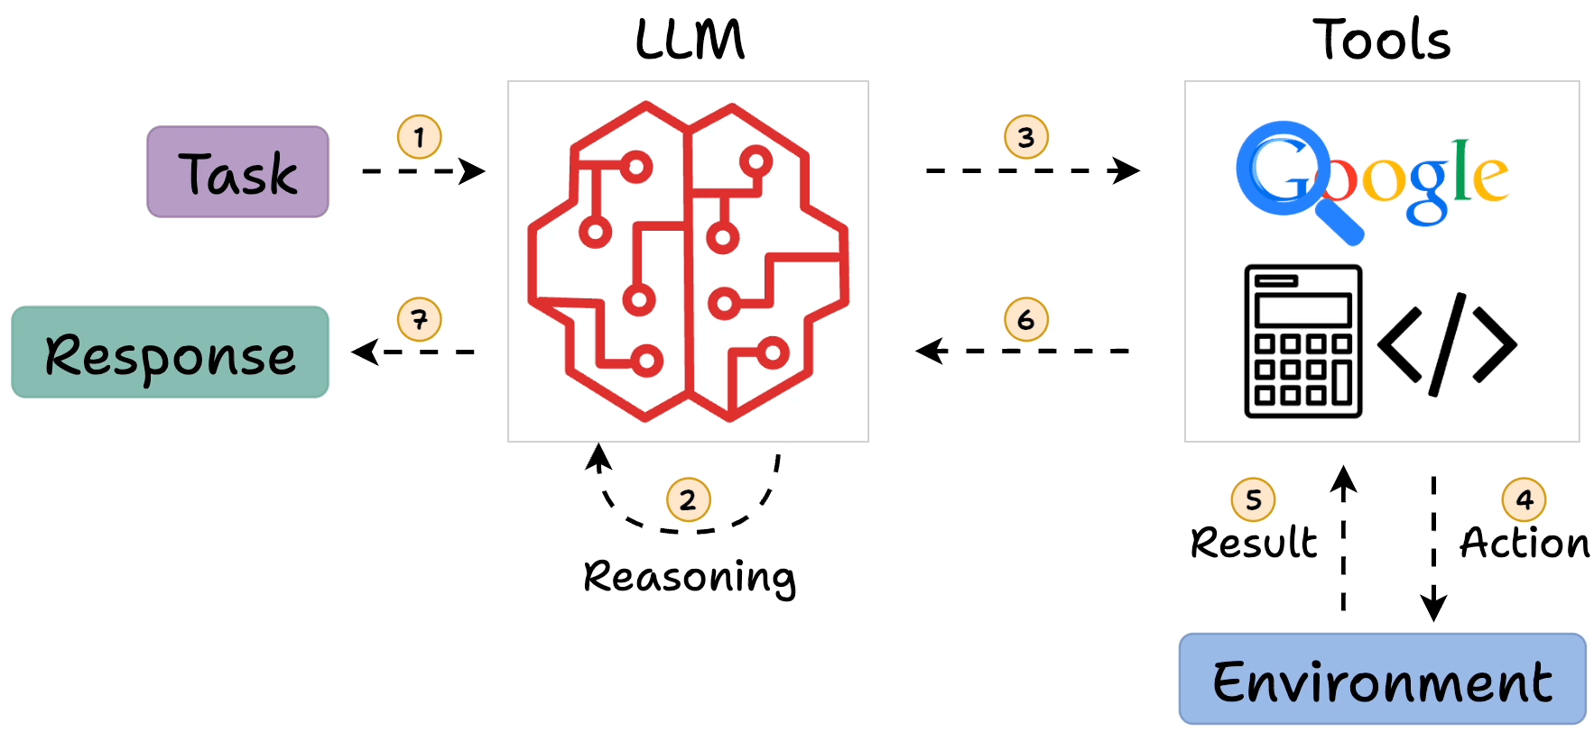
What is the (Reasoning) Agent?
https://blog.dailydoseofds.com/p/intro-to-react-reasoning-and-action
Notes:
The term agent in AI generally refers to an autonomous entity that can perceive, reason, and act in an environment to achieve a goal. We assume that the agent is the LLM agents. A Reasoning Agent, specifically, is one that employs an LLM to perform multi-step reasoning and decision-making, rather than just producing a single-shot answer.

Slide 14
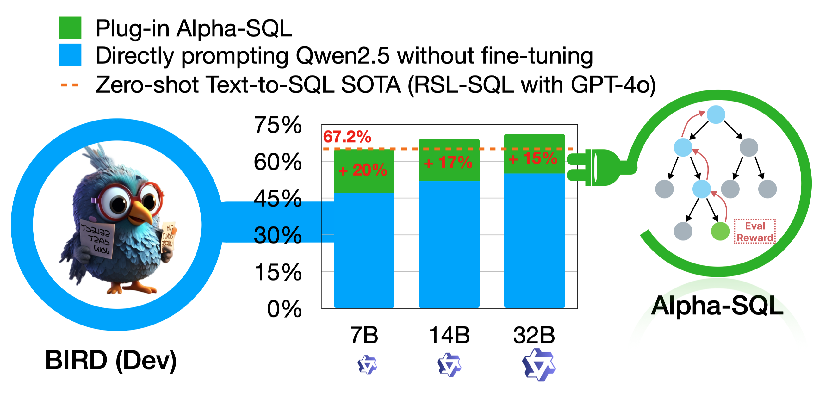
Alpha-SQL: A Plug-and-Play Text-to-SQL Reasoning Framework
Open-source LLMs
Training-free Paradigm
Dynamic Reasoning
Yuyu Luo, Alpha-SQL: Zero-Shot Text-to-SQL using Monte Carlo Tree Search, ICML 2025.
https://alpha-sql-hkust.github.io/
Notes:
Alpha-SQL is our proposed solution. We call it “plug-and-play” because it is designed to work with existing tools and models without additional training, and you can plug in different components as needed. The framework embodies three key characteristics:

Slide 15
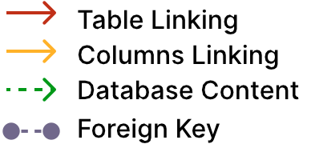
NL2SQL Human Workflow
Step-1 NL Understanding
Find the number of dog pets that are raised by female student
Find the number of dog pets that are raised by female student
Step-2 Schema Linking and Database Content Retrieval
Pets
PetID | PetType | PetAge | ...
 | Dog
Student
StuID | Sex | Age | ...
 | F
Has_Pet
PetID | StuID | ...
Step-3 & 4 Design SQL Logic & Compose SQL
Select count(*) FROM student AS T1 JOIN has_pet AS T2 ON T1.stuid=T2.stuid JOIN pets AS T3 ON T2.petid=T3.petid WHERE T1.sex=‘F’ AND T3.pettype=‘Dog’
Notes:
加

Slide 16
Task Formulation: Mimic Human Experts
No
Q
Test
Understand Intent
Link to Schema
Design SQL Logic
Compose SQL
Yes
SQL
DB
From Human Actions to Agent Actions
👷🏻‍♂️
🤖
Understand Intent
Question Rephrasing
(Revise, clarify ambiguities, rephrasing)
Link to Schema
Schema Selection
(decides which tables / columns / values)
Cell Value Selection
Design SQL Logic
Column Function
(joins, aggregations, functions)
Compose SQL
SQL Generation
(assemble an initial executable query)
Validate & Iter.
SQL Revision
(iteratively test, debug, and optimize the query)

Slide 17
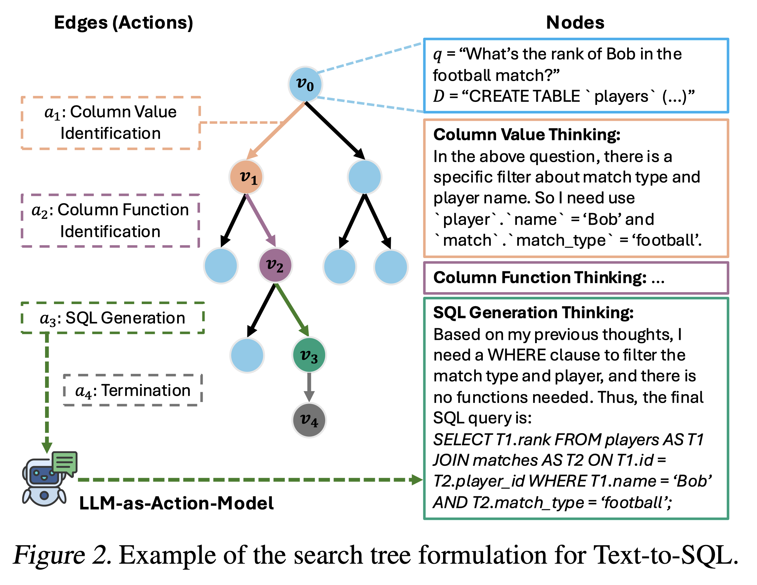
Task Formulation: Mimic Human Experts
No
Q
Test
Understand Intent
Link to Schema
Design SQL Logic
Compose SQL
Yes
SQL
DB
From the Fixed Action to Dynamic Actions
Tree-based Search:
Each edge corresponds to an agentic action in the query construction process,
Each node represents a reasoning state at a specific step, and
Each path corresponds to a sequence of SQL construction actions for Text-to-SQL task.

Slide 18





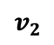
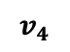
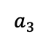
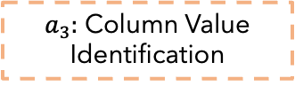
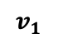
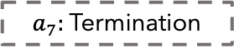
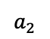
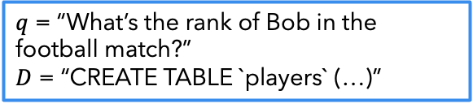
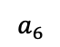
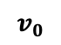
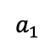
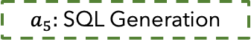
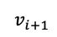
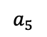
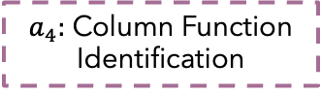
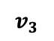
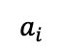
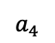
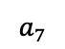
Text-to-SQL as a Tree-based Search Problem
Action Space
$$a_{1}$$
Rephrase Question
Edges (Actions)
Nodes (Reasoning States)
$$a_{2}$$
Schema Selection
$q$ = “What’s the rank of Bob in the football match?”
$D$ = “CREATE TABLE `players` (…)”
$$a_{3}$$
Column Value Identification
$$v_{0}$$
Question
Database
$a_{3}:$ Column Value
Identification
Input
$$a_{4}$$
Column Function Identification
Column Value Thinking:
In the above question, there is a specific filter about match type and player name. So I need use `player`.`name` = ‘Bob’ and `match`.`match_type` = ‘football’.
$$a_{5}$$
SQL Generation
$$v_{1}$$
$$a_{6}$$
SQL Revision
$a_{4}:$ Column Function
Identification
$$a_{7}$$
Termination
$$v_{2}$$
Column Function Thinking: …
LLM-as-Action-Model
$a_{5}:$SQL Generation
SQL Generation Thinking:
Based on my previous thoughts, I need a WHERE clause to filter the match type and player, and there is no functions needed. Thus, the final SQL query is:
SELECT T1.rank FROM players AS T1 JOIN matches AS T2 ON T1.id = T2.player_id WHERE T1.name = ‘Bob’ AND T2.match_type = ‘football’;
$$v_{3}$$
Question
Database
Previous
Actions
$a_{7}:$Termination
$$v_{4}$$
$$a_{i}$$
Output
$$v_{i+1}$$
Action
LLM
Next State
LLM-as-Action-Model

Slide 19
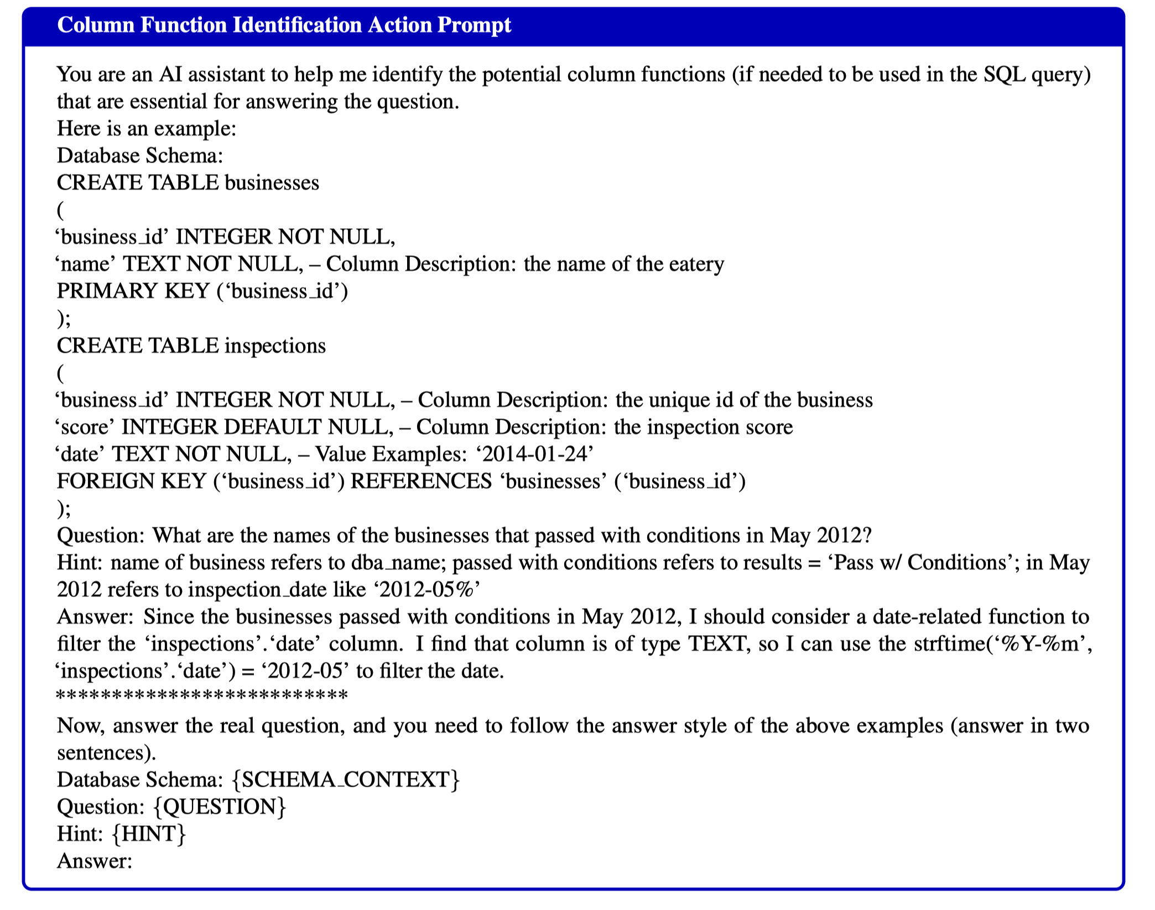
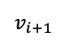
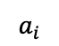
LLM-as-Action-Model
Question
Database
Previous
Actions
$$a_{i}$$
$$v_{i+1}$$
Action
LLM
Next State

Slide 20
Text-to-SQL as a Tree-based Search Problem
Q1: How to select the next action (edge)?
Q2: How to effectively navigate the vast search space?
Q3: How to evaluate the quality of the candidate SQL queries?
Q1 & Q2
Monte Carlo Tree Search (MCTS) addresses this by balancing exploration (testing uncertain actions) and exploitation (choosing actions likely to yield good results)
Q3
We need a self-supervised reward function since our goal is to avoid reliance on labeled data
Resampling the LLMs M times to compute the self-consistent scores

Slide 21
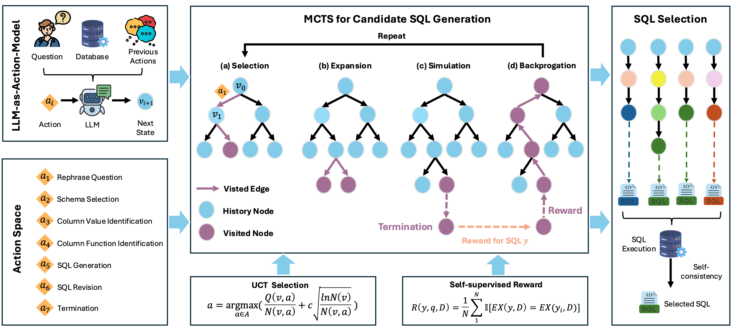
Alpha-SQL Solution Overview
Alpha-SQL: Zero-Shot Text-to-SQL using Monte Carlo Tree Search, ICML 2025.
https://alpha-sql-hkust.github.io/

Slide 22
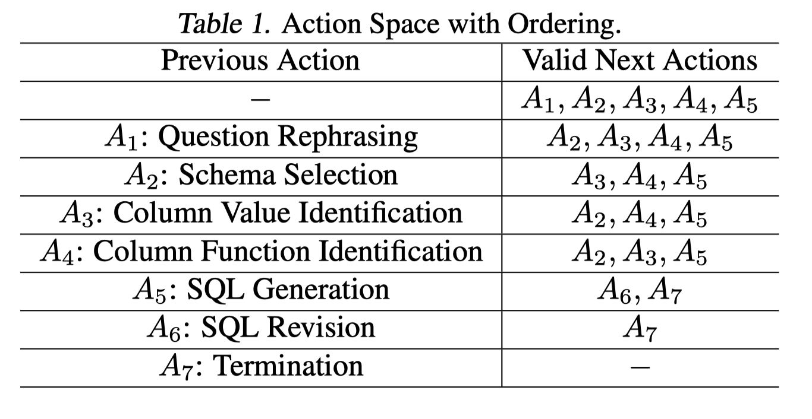
Pruning the Candidate Actions (for efficiency)
Action Ordering and Constraints
Each reasoning trajectory follows a structured, ordered sequence to ensure logical consistency.
Certain actions (e.g., SQL Revision) can only be performed after specific preceding actions.
Each action can occur only once within a single reasoning path, preventing infinite loops.

Slide 23
Pruning the Search Paths (for efficiency)
Alpha-SQL incorporates schema constraints and semantic rules into the search process to prune invalid paths early.
A key aspect of our pruning strategy is the elimination of redundant nodes. For example, when performing a Schema Selection action, we may sample the LLM M multiple times (e.g., 3 times). Although the Chain-of-Thought content generated by M may differ in each sample, if the final selected schema subset is identical, we create only one child node instead of three duplicate nodes. This de-duplication significantly reduces the branching factor of the search tree without loss of information.

Slide 24
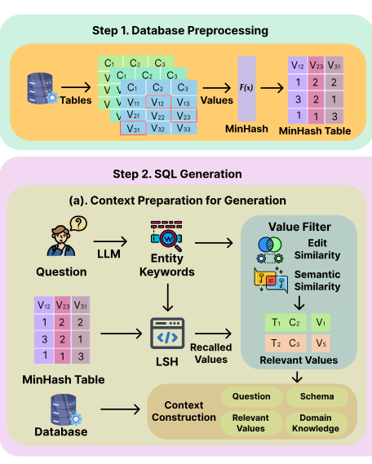
Offline: Database Value Retrieval
The databases value are extracted and processed offline.
First, we extract keywords from questions using few-shot LLM prompts.
We then use LSH to retrieve relevant values, filtering them based on editing similarity and semantic similarity thresholds (ϵedit , ϵsemantic ).
The semantic matching employs OpenAI’s text-embedding-3-large model. The retrieved values will be used as part of the database schema prompt for our LLM-as-Action-Model module.

Slide 25
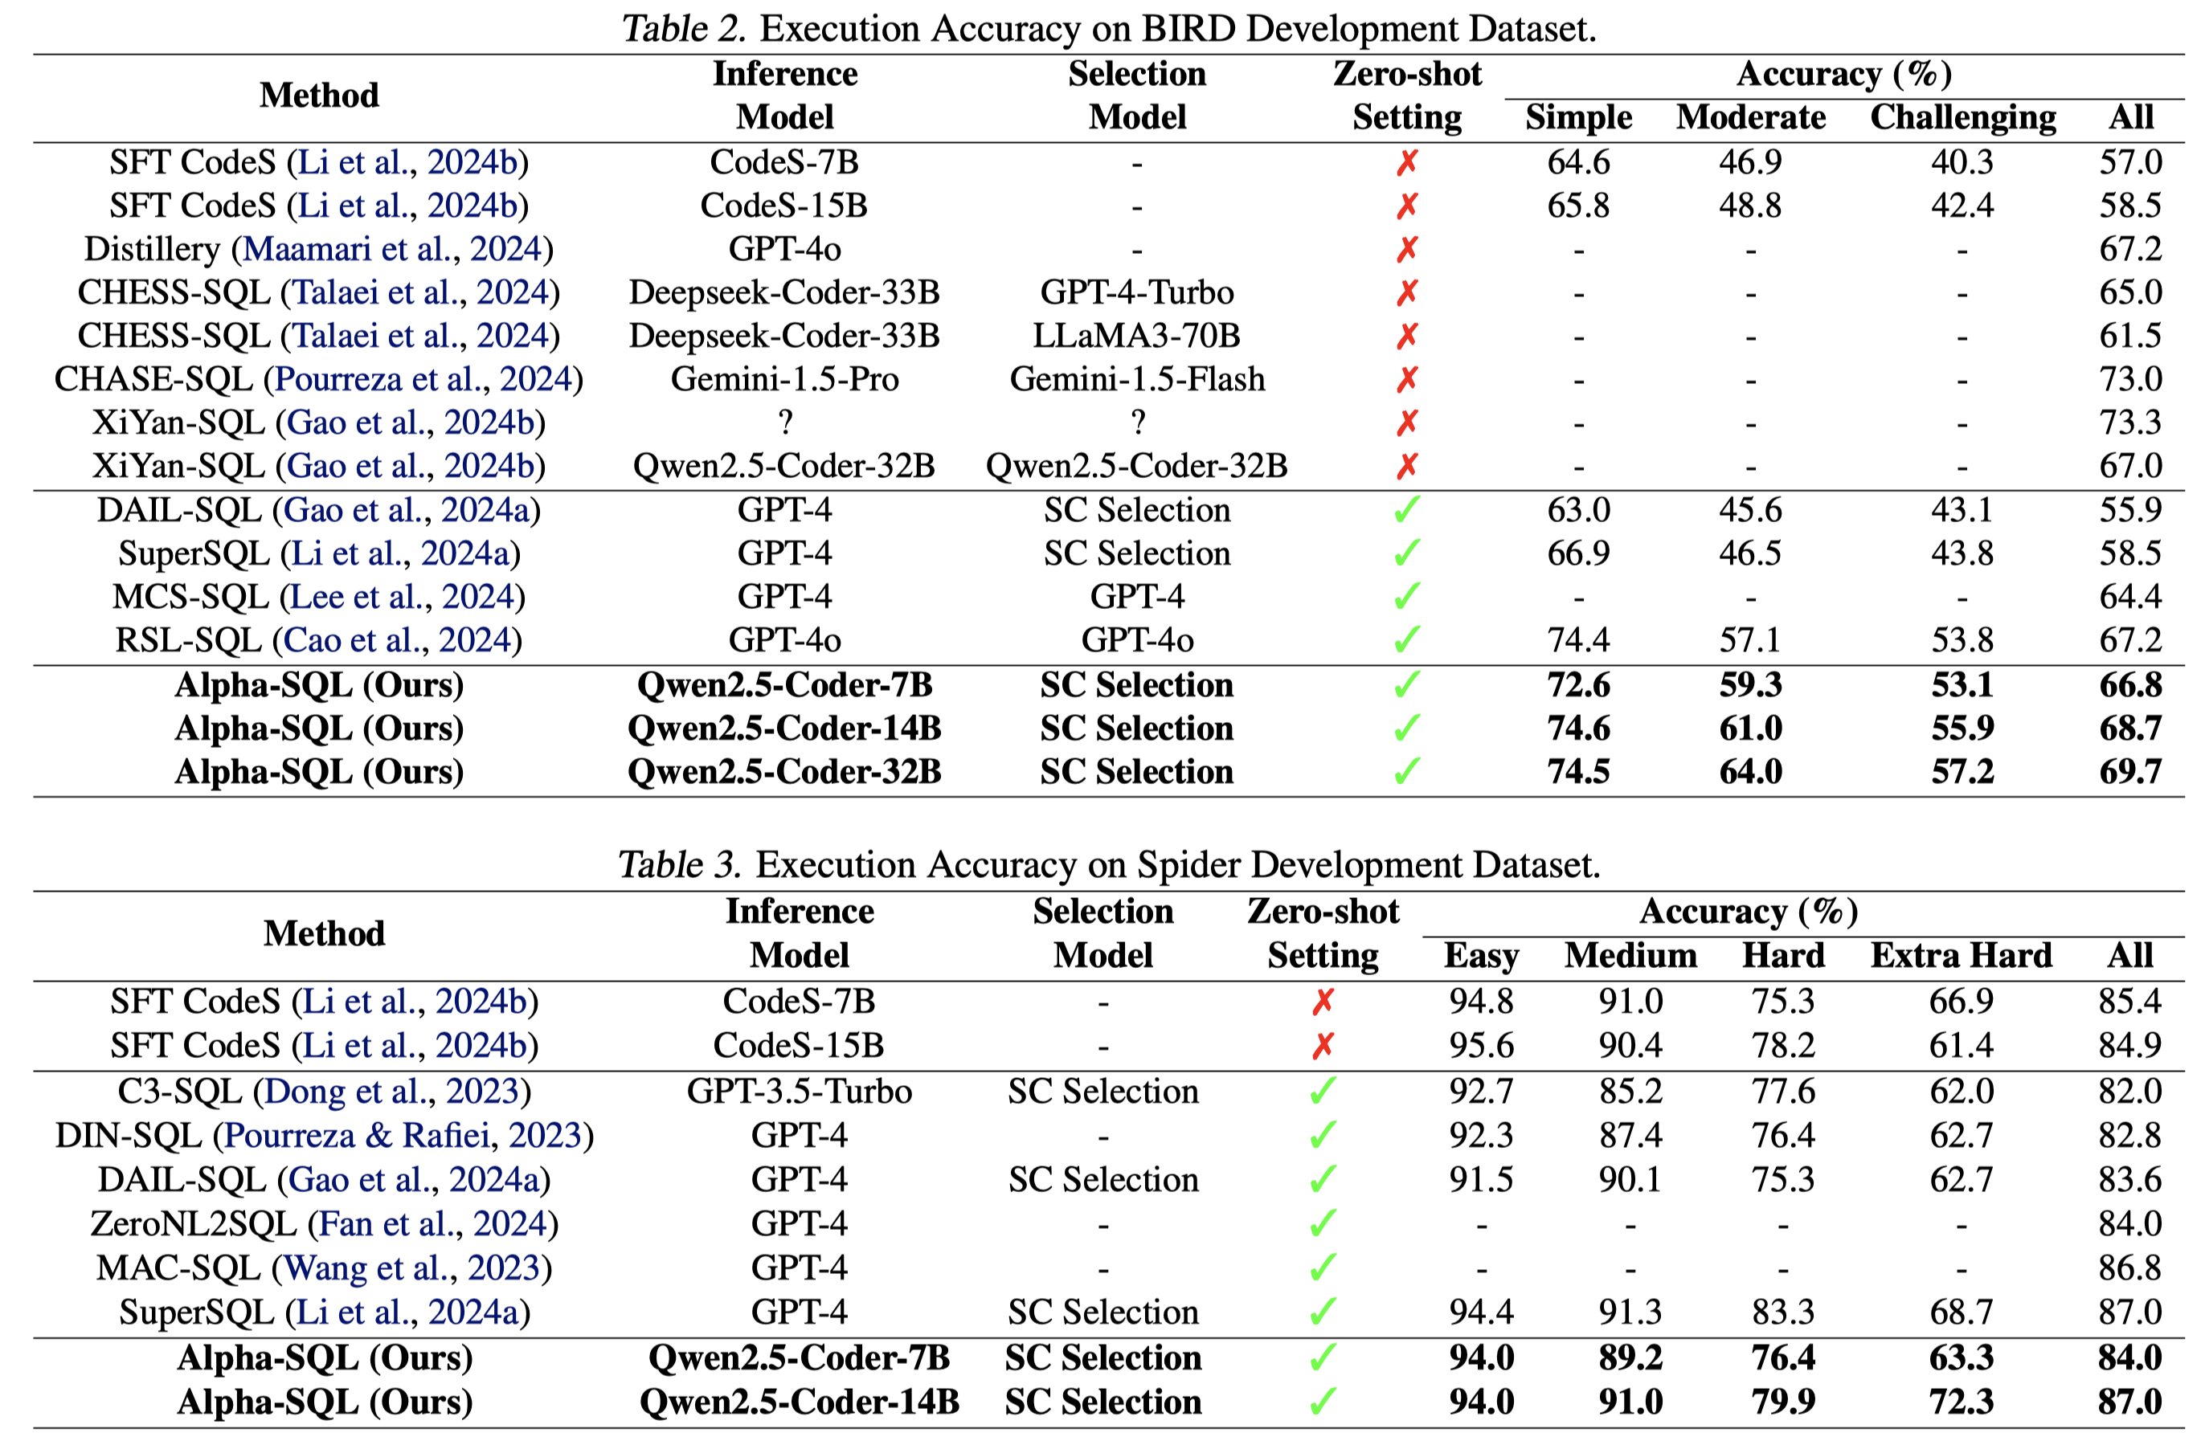
Alpha-SQL: Effectiveness
*模型名称后的“-7B”意味着模型约有70亿参数量。

Slide 26
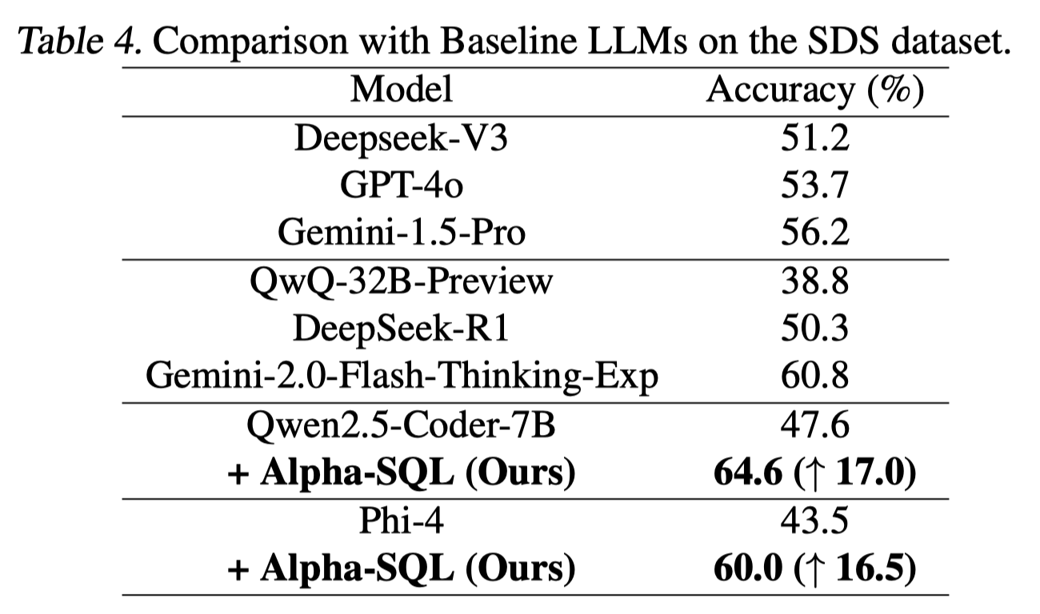
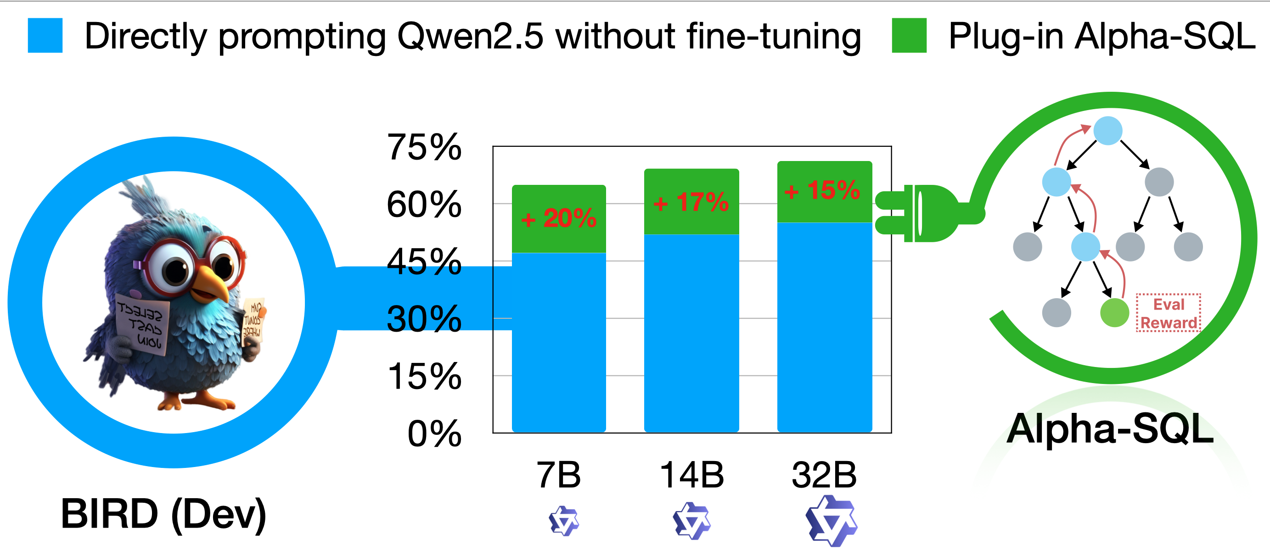
Alpha-SQL: Plug-and-Play Capabilities

Slide 27
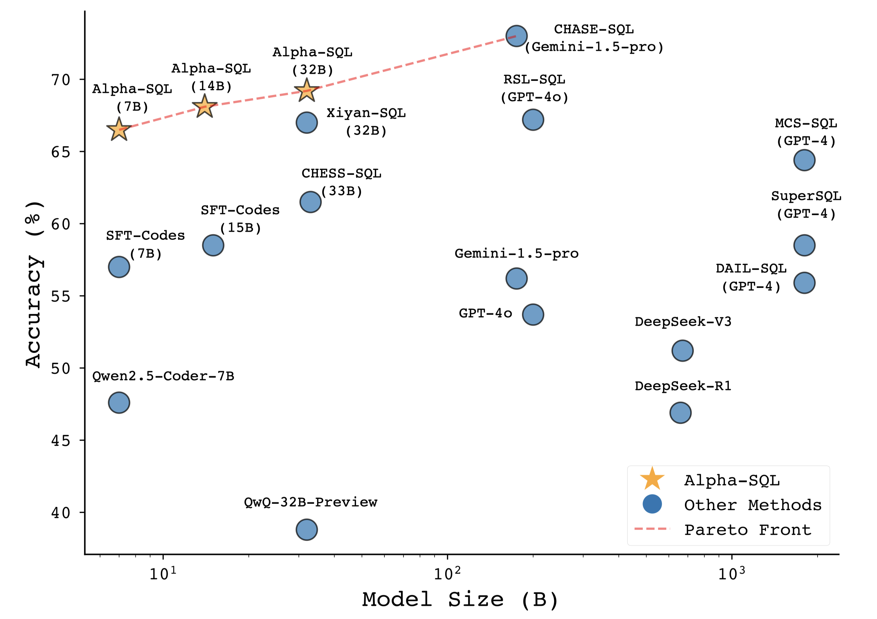
Performance-Scale Trade-off Analysis

Slide 28
Research Opportunities
Human-as-an-Agent and Human-in-the-Reasoning-Loop
How can we dynamically integrate human experts into the reasoning loop to address complex tasks beyond LLM agents‘ current capabilities and clarify the question ambiguities?
Explainable and Interpretable SQL Reasoning Agents
Users typically require explanations for the reasoning steps and decisions underlying SQL generation (i.e., knowing both "what" and "why").
How can we design reasoning agents that transparently communicate their thought processes, decisions, and final SQL statements to improve system transparency and foster user trust?
Metadata Management and Schema Interpretation
Real-world databases commonly feature complex schemas, detailed metadata (e.g., column annotations, table descriptions, foreign key constraints, data types).
How can we enable data agents to effectively extract, manage, and utilize this metadata to generate more accurate semantic mappings, informed reasoning processes, and precise SQL generation?

Slide 29
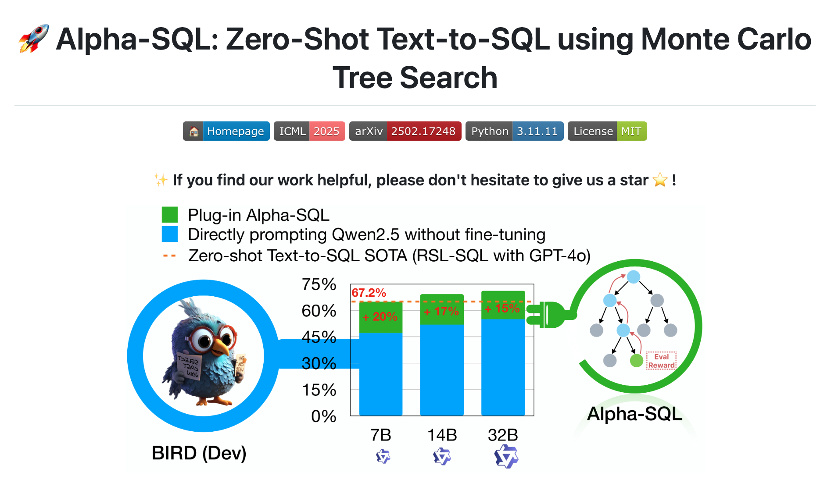
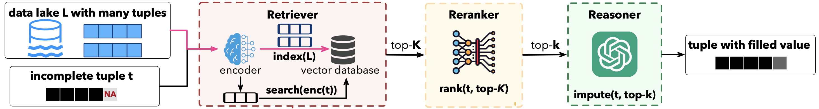


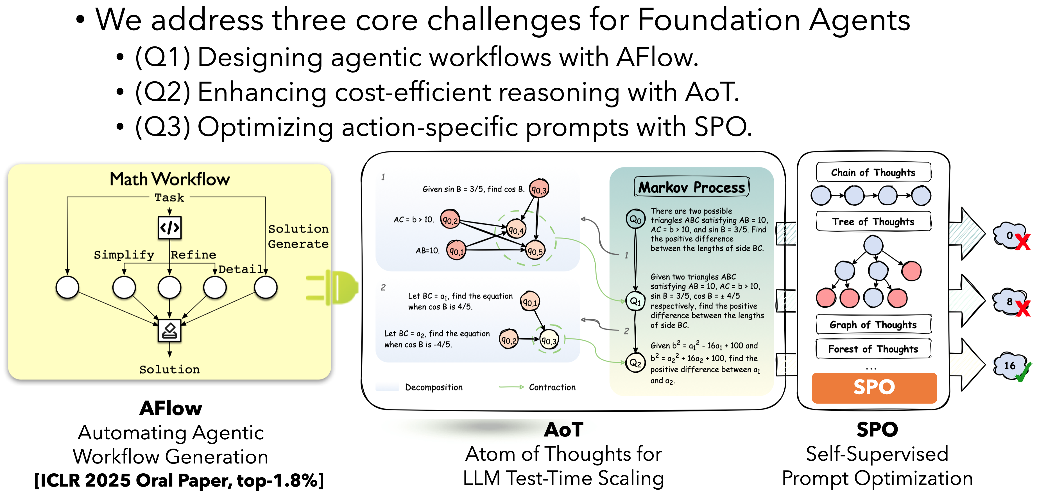
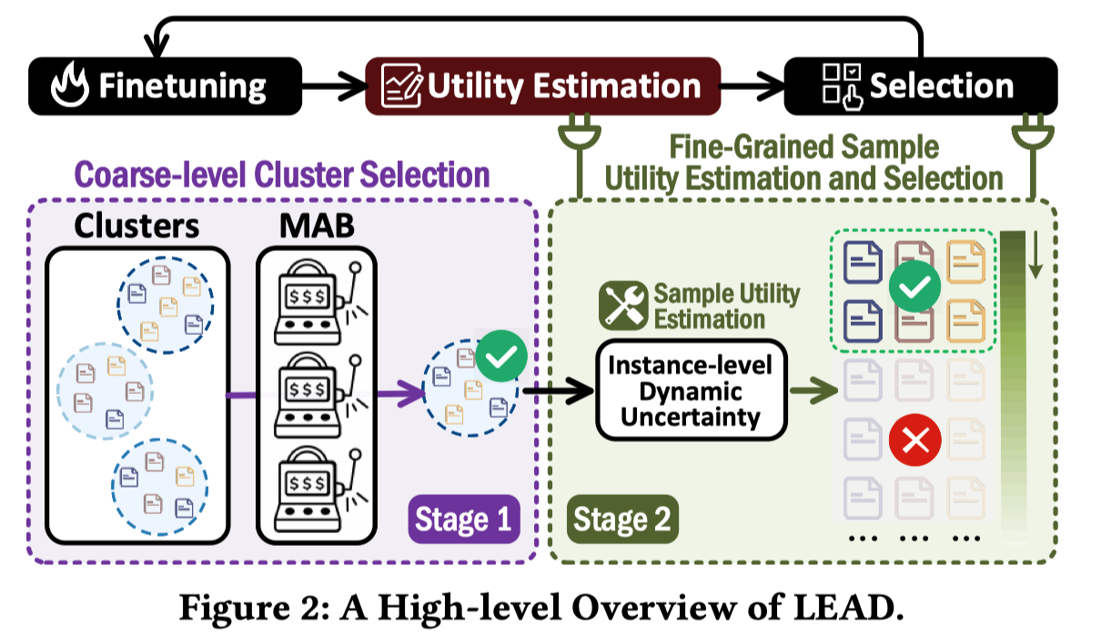
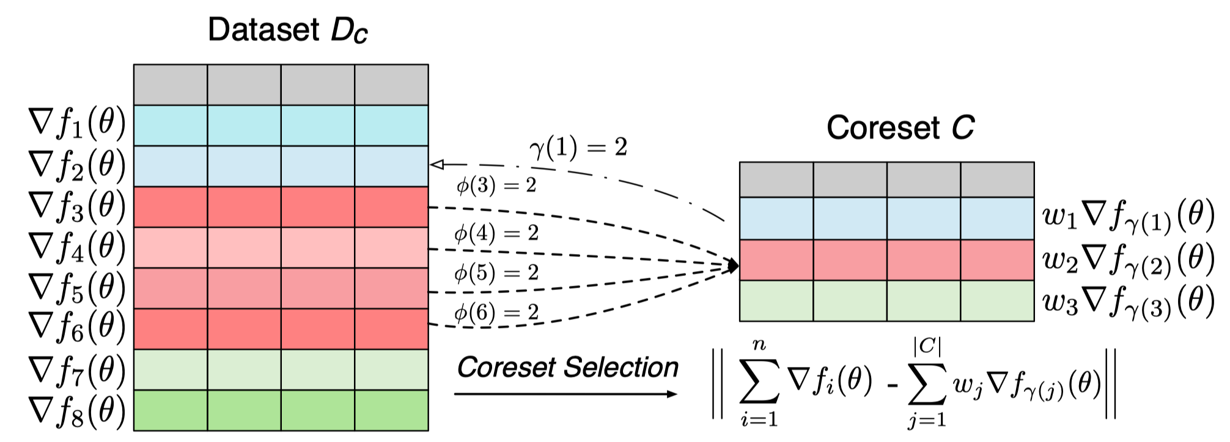
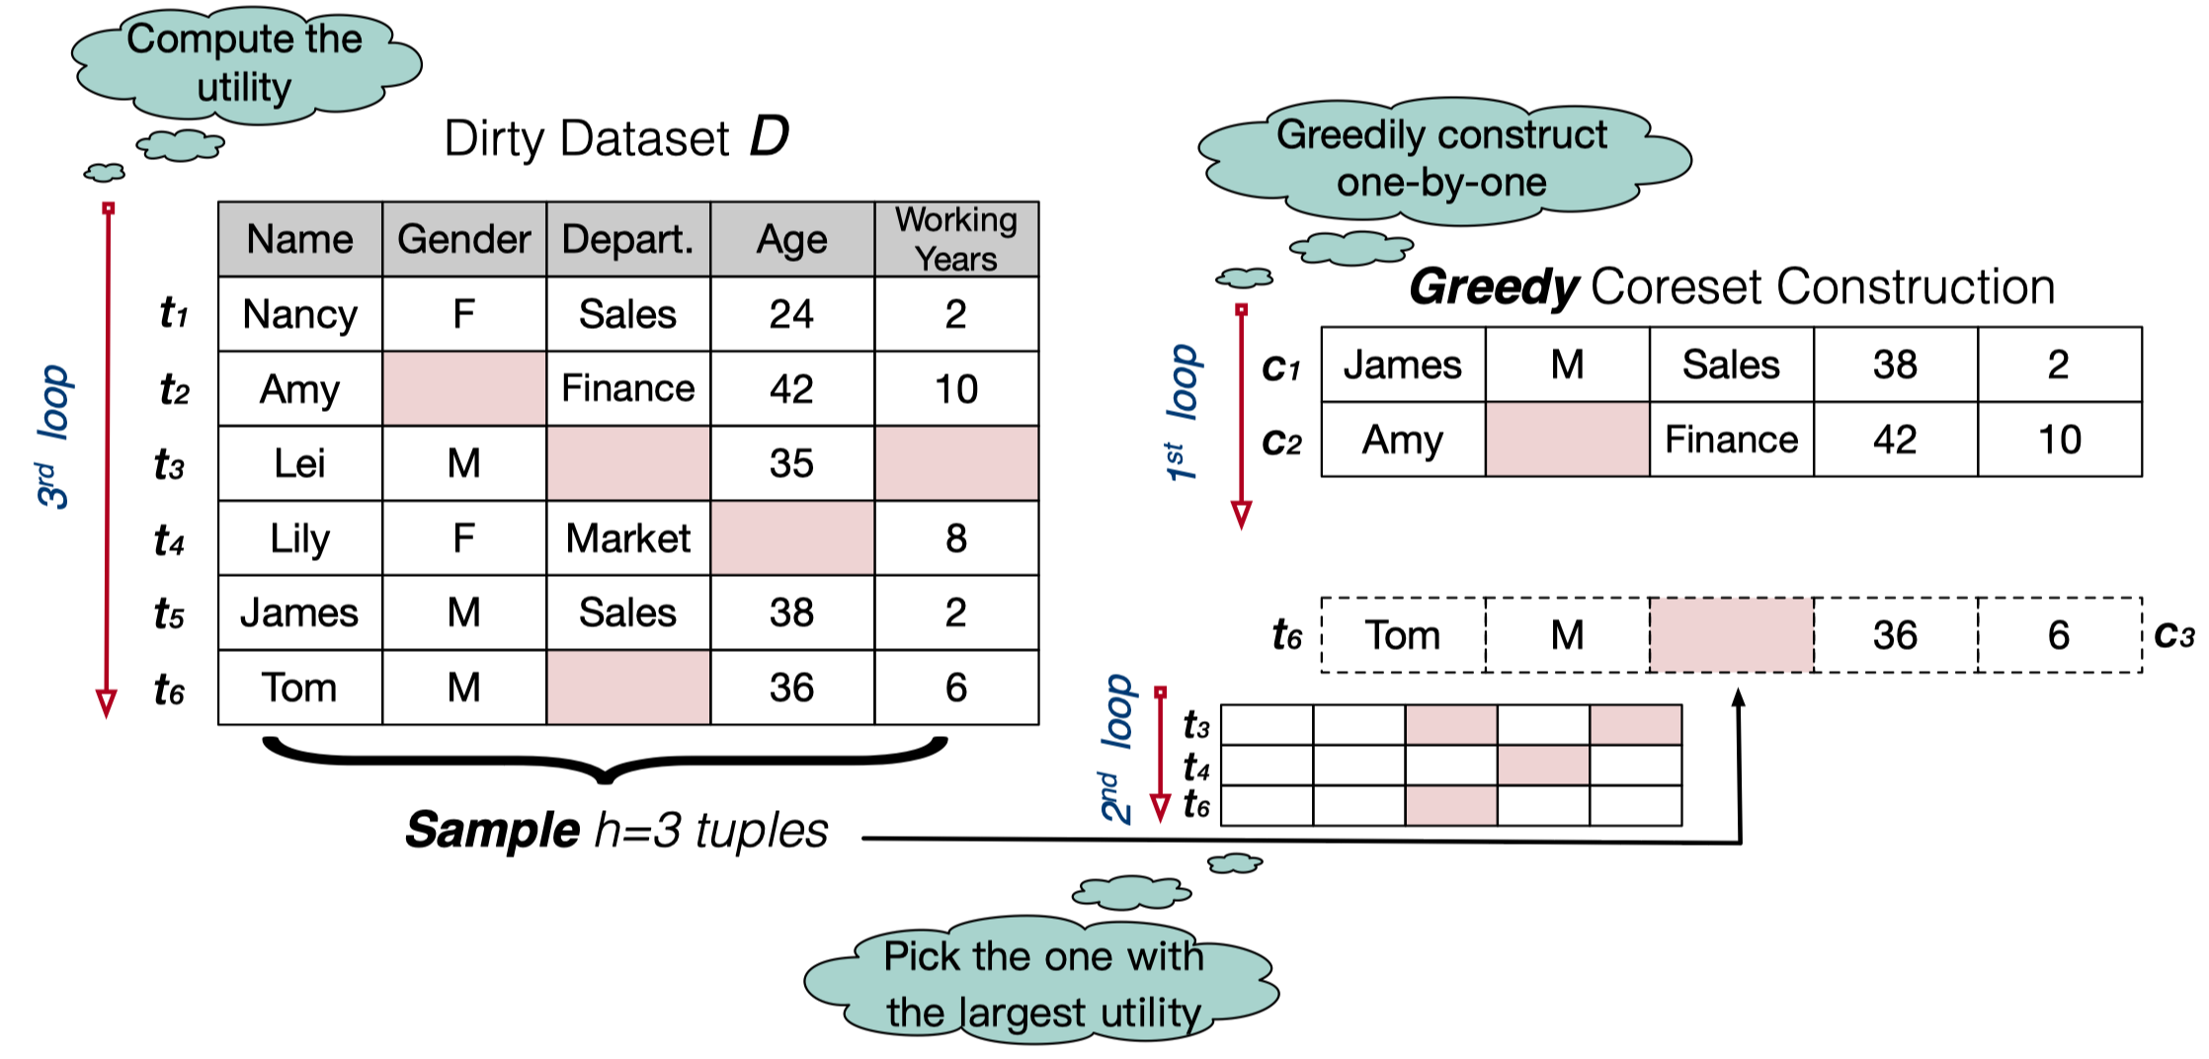
Agents-powered Data Analytics
RAG
Text-to-SQL
Document QA
Data Visualization
[SuperSQL, VLDB 2024]
[Alpha-SQL, ICML 2025]
[NL2SQL-Bugs, KDD 2025]
[LineNet, SIGMOD 2023]
[HAIChart, VLDB 2024]
[LakeFill, VLDB 2025]
[StatQA, NeurIPS 2024]
[Weak2Strong, VLDB 2025]
[HARVis, CHI 2025]
LLMs & Agents
1. OpenManus: An open-source framework for building general AI agents
2. From LLM Agents to Foundation Agents
[ICLR 2025, Oral Paper, Top-1.8%]
https://github.com/HKUSTDial/Alpha-SQL
Thanks!
Dr. Yuyu LUO
Data Science and Analytics Thrust
Information Hub, HKUST(GZ)
yuyuluo@hkust-gz.edu.cn
http://luoyuyu.vip
Data-centric AI
[TODS 2025, VLDB 2022]
GoodCore: Data-effective and Data-efficient Machine Learning
Iterative Data Selection
for LLM Instruction Tuning
Best-of-SIGMOD 2023 Papers (CCF-A)

Slide 30
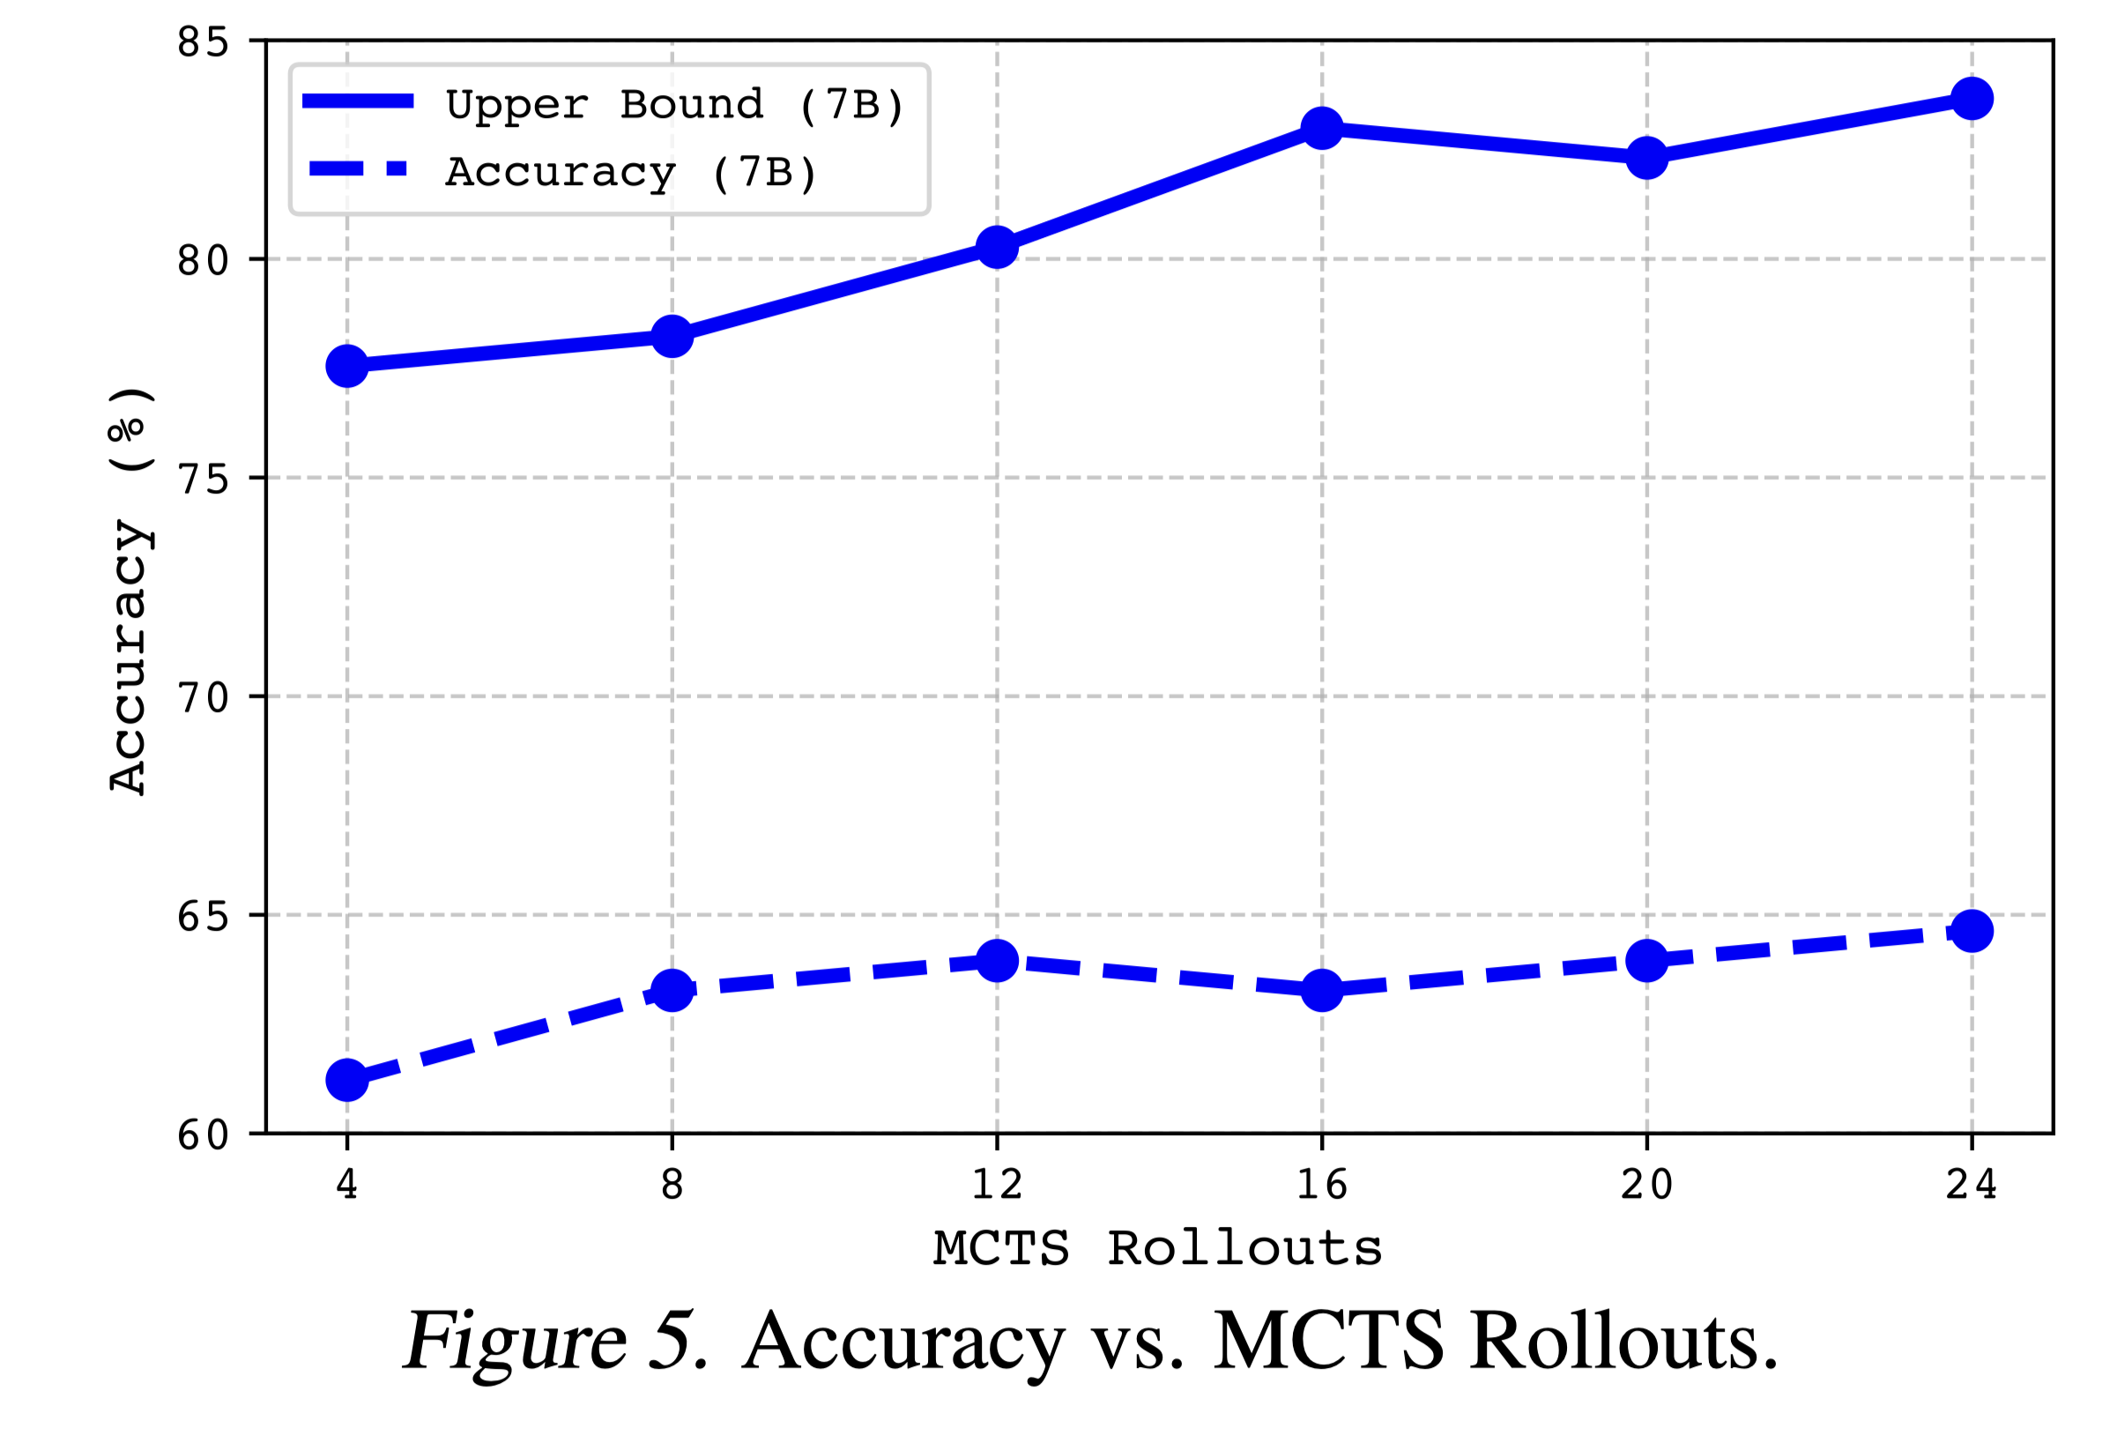
Alpha-SQL: Upper Bound Accuracy

Slide 31
Alpha-SQL: Top-K Accuracy
Methods | Base LLMs | Top-K | Accuracy
Alpha-SQL | Qwen2.5-Coder-32B | Top-1 | 69.7%
Alpha-SQL | Qwen2.5-Coder-32B | Top-2 | 78.4%
Alpha-SQL | Qwen2.5-Coder-32B | Top-3 | 80.8%
Alpha-SQL | Qwen2.5-Coder-32B | Top-4 | 81.6%
Alpha-SQL | Qwen2.5-Coder-32B | Top-5 | 81.7%

